Slide 1


Hotel & Catering Law
An Examiner Guide
March 2021 series

Slide 2
Synopsis:
Examination areas where candidates showed good practice
Examination areas for candidate development
Individual question breakdown
Recommendations

Slide 3
Areas of good practice
Gross Misconduct (Question 1)
Fire safety legislation (Question 6(a))
An employer’s health, safety and welfare responsibilities in the workplace
(Question 6(b))
Protected characteristics under disability legislation (Question 7(a))
Prohibited sale of alcohol (Question 8(b))

Slide 4
Areas for candidate development
The Sale of Goods Act 1979 (Question 4)
Breach of The Sale of Goods Act 1979 (Question 4)
Advantages and Disadvantages of setting up and running a limited company (Question 5)
Permitted hours on licensed premises; the sale of draught beer; music licensing in a restaurant setting (Question 8(a), (c), (d))

Slide 5
Individual Question Breakdown
Question 1:
An employer may state that certain types of employee behaviour are so serious that they constitute gross misconduct. Describe ten actions that an employer would consider to be gross misconduct. Use examples to support your description. [20 marks]
QUESTION 1 PART ANSWER EXAMPLE:
Introduction:
An employee is culpable for gross misconduct if they have breached a term or condition within their contract of employment by engaging in behaviour so grave that the employer is entitled to bring their contract to an end without notice. This is known as summary dismissal. 1 mark
Source: Principles of Hospitality Law, Michael Boella and Alan Pannett, Second edition (1999), p301

Slide 6
Individual Question Breakdown cont.
QUESTION 1 PART ANSWER EXAMPLE continued:
Refusal to carry out the employer’s reasonable instructions 1 mark
An employer may consider an employee’s refusal to comply with a reasonable request to be gross misconduct. In the case Pepper v Webb [1969], a gardener’s refusal to obey instructions was held to be a breach of his implied duty and warranted his summary dismissal. 1 mark
However, an employer must be shown to have exercised professional judgement. For example, if an employee fails to adhere to policies and procedures but is not adequately supervised, the employee’s action may not constitute gross misconduct. 1 mark
Source: Principles of Hospitality Law, Michael Boella and Alan Pannett, Second edition (1999), pp.301-2

Slide 7
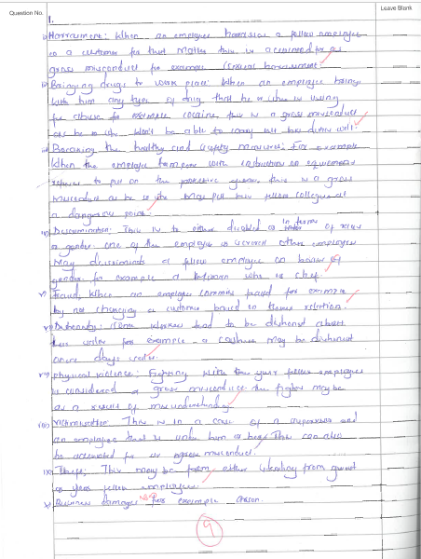
Individual Question Breakdown cont.
QUESTION 1 – Candidate paper
Areas of good practice: Areas for candidate development:
No introduction or conclusion
Excellent structure
Has demonstrated clear and succinct
knowledge of actions that constitute
gross dismissal
Insufficient supporting detail or depth (see
previous slide)

Slide 8
Individual Question Breakdown cont.
Question 2:
When disputes arise between businesses, clients, customers or departments the parties involved have to decide how the dispute can be resolved.
(a) Explain the process that a business would follow when resolving a dispute. [6 marks]
(b) Describe seven processes that must be followed during arbitration. [14 marks]
TEXTBOOK REVISION!
QUESTION 2(b) PART ANSWER EXAMPLE:
Introduction: Arbitration is a contract-based form of dispute resolution, which lies outside the court system, whereby parties agree to be bound by the decision of an appointed sole arbitrator or arbitration panel. 1 mark
One process that must be followed during arbitration is that the issues for determination should be identified. 1 mark These can be issues of fact, law or damages payable 1 mark and parties may contest the arbitrator’s jurisdiction to decide part or all of a particular issue. 1 mark
Source: Principles of Hospitality Law, Michael Boella and Alan Pannett, Second edition (1999), pp.27-28

Slide 9
Individual Question Breakdown cont.
Question 3:
Security concerns can affect many areas of a business.
(a) Describe the contents of a security policy. [10 marks]
(b) Explain factors the management of a hotel must consider when offering car parking facilities to its guests. [5 marks]
(c) Explain the importance of a hotel security policy. [5 marks]
QUESTION 3(a) PART ANSWER EXAMPLE:
Aspect of security policy: Money handling 1 mark
Most major companies will account for money handling as part of their security policy. This will likely include information on the handling and banking of cash, retaining cash on the premises, use of the safe and tills and wages for manual staff. 1 mark
Source: Principles of Hospitality Law, Michael Boella and Alan Pannett, Second edition (1999), pp.98-101

Slide 10
Individual Question Breakdown cont.
Question 4:
A contract for the sale of food and drink is formed in different ways and at various times according to the nature of the establishment. Describe how The Sale of Goods Act 1979 operates and what possible offences can occur if the Act is not followed. Use examples to support your description. [20 marks]
STRUCTURE:
Overview of relevant legislation > state the nature and varying functions of the Sale of Goods Act 1979
Incidents of non-compliance > which offences do breach of legislation give rise to?
Practical supporting examples
Source: Principles of Hospitality Law, Michael Boella and Alan Pannett, Second edition (1999), pp.223-227

Slide 11
Key terms derived from question set:
Sale of Goods Act 1979
Operation of the Act
Possible offences
Examples
Individual Question Breakdown cont.
Develop good practice by:
Citing relevant legal provision
Demonstrating associated substantive detail
Addressing specific element of question
Supplementing with example or practical detail
s.14 Sale of Goods Act 1979 (SOGA) implies a contractual term of satisfactory quality for the sale of goods, according to the objective standard of a reasonable person. Influencing factors include description, price, fitness for purpose and durability. Therefore, a possible offence under s.14 SOGA is the sale of incompatible goods which results in property damage, (4) as such provision breaches the implied condition of fitness for purpose, as per the contaminated engine in the case of Bernstein v Pamson Motors (Golders Green) Ltd [1987].
QUESTION 4 PART ANSWER EXAMPLE:
Source: Principles of Hospitality Law, Michael Boella and Alan Pannett, Second edition (1999), pp.223-227

Slide 12
Advantages | Disadvantages
Status – gives the illusion of prestige and the business is large | Administrative burden – Tax return, annual accounts and annual return must be completed
Company name – protected and no other company can be formed with the same name | Responsibilities- Directors have a personal responsibility to deliver statutory documents to Companies House, failure is a criminal offence & penalties are applied
Investors – attracts more investors than a sole trade or partnership since investments have more protection and security | Less privacy – Company details are held on public record
Finance – Banks are more likely to lend money for similar reasons as investors | Finance – Personal guarantees from Directors may be required making Directors liable for debts
Liability is limited by the amount unpaid on shares | Accountancy fees – Often higher than an unincorporated company due to the number of reporting requirements
Liability may be limited by guarantee
Tax relief – Some expenses can attract tax relief subject to certain conditions
Individual Question Breakdown cont.
Question 5:
Explain the advantages and disadvantages of setting up and
running a limited company. [20 marks]
KEY CONSIDERATIONS:
Status
Security of company name
Investment potential
Securing finance
Liability
Taxation
Administrative burden
Responsibilities
Privacy
Fees
Source: Principles of Hospitality Law, Michael Boella and Alan Pannett, Second edition (1999), pp.46-48

Slide 13
Individual Question Breakdown cont.
Question 6:
Employers and employees have a legal duty to ensure the health, safety and welfare of every person on the premises.
(a) Discuss how each of the following must be inspected to ensure that premises comply with fire safety legislation:
(i) Means of escape
Methods of preventing fire from spreading
Means of giving warning [10 marks]
(b) Explain five responsibilities an employer has to ensure the safety and welfare of employees in the workplace. [10 marks]
QUESTION 6(b) PART ANSWER EXAMPLE:
In accordance with s2. Health and Safety at Work Act 1974 1 mark, an employer must provide, so far as is reasonably practicable, the necessary information, instruction, training and supervision to maintain the health and safety at work of his employees. 1 mark
Source: Principles of Hospitality Law, Michael Boella and Alan Pannett, Second edition (1999), pp.90-95
pp.345-350

Slide 14
Individual Question Breakdown cont.
Question 7:
The Disability Discrimination Act (1995) and Equality Act (2010) both prevent an employee being treated less favourably because of their disability.
(a) Explain the types of disabilities categorised under these Acts. [8 marks]
(b) Describe the ways in which an employer could unlawfully discriminate against a person on the grounds of their disability. [12 marks]
‘Protected characteristics’ are specific aspects of a person's identity and are incorporated within disability legislation
Types of disabilities
Progressive conditions, e.g. arthritis, motor neurone disease (MND), dementia
Physical, e.g. cerebral palsy, epilepsy, multiple sclerosis (MS), amputations
Sensory conditions, e.g. blindness, deafness, speech impairment
Mental health, e.g. anxiety, depression, bipolar, eating disorders
Learning disabilities, e.g. dyslexia, dyspraxia
Source: Principles of Hospitality Law, Michael Boella and Alan Pannett, Second edition (1999), pp.167-168, p327

Slide 15
Individual Question Breakdown cont.
Candidates may develop good practice by:
Ensuring accuracy between protected characteristics and disability discrimination, e.g. other protected characteristics in the Equality Act 2010 such as age, ethnicity, gender and sexual orientation are not disabilities and therefore not materially relevant to a question on disability discrimination.
QUESTION 7(b) PART ANSWER EXAMPLE:
A disabled person can take their employer to tribunal if they are denied a new job opportunity owing to a negative reference. For example, if the employer’s negative reference is motivated by the employee’s disability-related absence, it will likely amount to unlawful disability discrimination as the job offer had been withdrawn as a direct result of the negative reference.
Source: Principles of Hospitality Law, Michael Boella and Alan Pannett, Second edition (1999), pp.167-168, p327

Slide 16
Source: Principles of Hospitality Law, Michael Boella and Alan Pannett, Second edition (1999), pp.244-261
Individual Question Breakdown cont.
Question 8:
The sale and supply of alcohol is an activity controlled by law.
(a) Explain what is meant by permitted hours on licensed premises. [5 marks]
(b) Identify the persons to whom alcohol must not be sold. [5 marks]
(c) Explain the legal position regarding the sale of draught beer. [5 marks]
(d) State the licenses required for playing background music in a restaurant. [5 marks]
QUESTION 8(a) ANSWER EXAMPLE:
It is a criminal offence for licensed premises to sell or supply alcohol outside of certain hours, known as permitted hours. 1 mark Under previous legislation, namely s.59 Licensing Act 1964 1 mark, permitted hours were set from 11am-11pm, with 20-minute drinking-up time allowed after hours and scope for food and entertainment extensions in operation. 1 mark
Legislation has since been updated and permitted hours fall within part of the Licensing Act 2003 1 mark, which permits the 24 hour sale of alcohol. Hours are determined by the premises licence and hours differ among premises. 1 mark

Slide 17
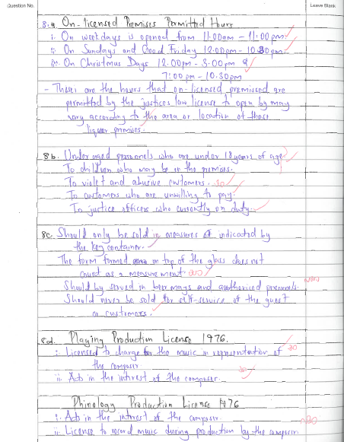
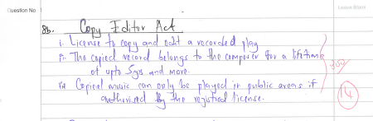
Individual Question Breakdown cont.
QUESTION 8 – Candidate paper
Areas of good practice: Areas for candidate development:
Competent textbook revision in relation
to permitted hours, prohibited sale and
specific legalities of selling draught beer
Add depth and detail to knowledge of legal
provisions regarding music licensing
Source: Principles of Hospitality Law, Michael Boella and Alan Pannett, Second edition (1999), pp.244-261

Slide 18
Recommendations
Consider taking a few minutes to comprehensively review the question paper. For example, it may be helpful to read a multi-part or case study question more than once to fully assimilate its demands. It might also be useful to underline parts of a question to keep on topic, in addition to making a few notes on scrap paper to help structure an answer. However, be mindful to keep the planning process to a few minutes.
Use past papers and sample answers as a revision guide only. Although a question may be similar to one set in a previous year’s examination, the areas of law covered within Hotel & Catering law are multi-faceted and contain different legal topics.
Exercise economical judgement when citing legislation or case law. For example, candidates are not required to write out entire legislative provisions or lengthy accounts detailing the facts of a case. Instead, candidates must succinctly cite the relevant law and apply their knowledge to the question set. It is possible to secure marks for methodology and reasoning, in the absence of forgotten legislation and case law.

Slide 19
Summary:
Examination areas where candidates showed good practice
- Gross Misconduct
- Fire safety legislation
- An employer’s health, safety and welfare responsibilities in the workplace
- Protected characteristics under disability legislation
- Prohibited sale of alcohol
Examination areas for candidate development
- The Sale of Goods Act 1979
- Breach of The Sale of Goods Act 1979
- Advantages and Disadvantages of setting up and running a limited company
- Permitted hours on licensed premises; the sale of draught beer; music licensing in a restaurant setting
Individual question breakdown
Engaged with the specific demands of each question set within March 2021 examination paper
Recommendations
Planning; past papers; keeping on-topic

Slide 20
CONCLUSION
Hotel & Catering Law
An Examiner Guide
March 2021 series

