Slide 1
Food Service Styles
Lesson 2
HS1/2

Slide 2
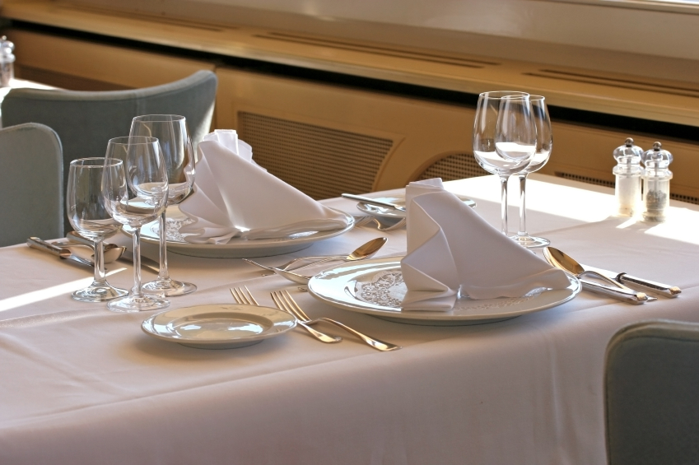
Table settings

Slide 3
Gueridon service
Food is served from a side table or trolley using a spoon & fork. A very specialist, skilled service which requires individual attention.
Sometimes dishes are assembled or cooked in front of the customer e.g.
Filleting a Dover Sole
Waldorf salad

Slide 4

Silver service
Food is served by the staff using spoon and fork. Full silver service includes serving all items this way.
Semi-silver service is when the meat or fish is served pated and vegetables are served with a spoon and fork.
This type of service can slow the service of food down and it needs skill to do it

Slide 5
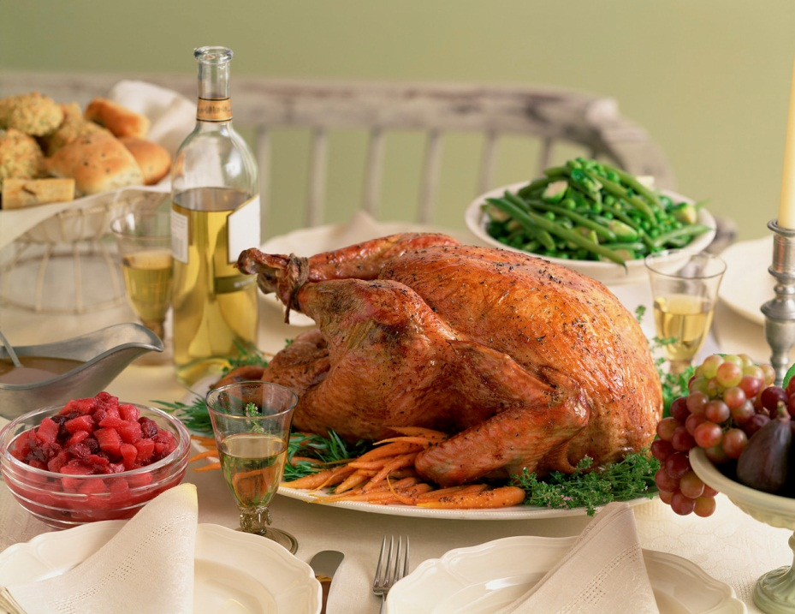
Family service
Dishes are put on the table where spoons are provided and customers serve themselves. This style is often suited to ethnic restaurants such as Indian, Chinese and Spanish tapas

Slide 6
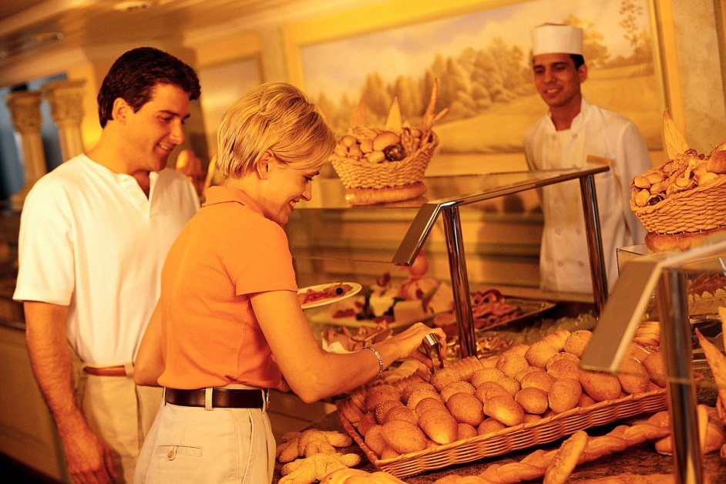
Buffet service
Set up in a room usually along one table, it can be self-service or staff can serve customers. A carvery may be offered where joints of meat are carved in front of customers and served to their plate

Slide 7
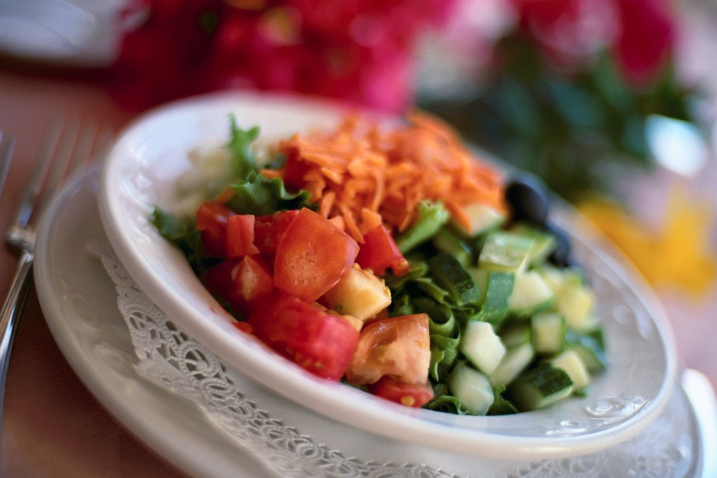
Plated service
The most popular style of service
is the plated service where all food
is put on the plate and served from the kitchen
Cafes, Restaurants and Hotels may all use this style of service and is maintains
consistency of service and
presentation

