Slide 1
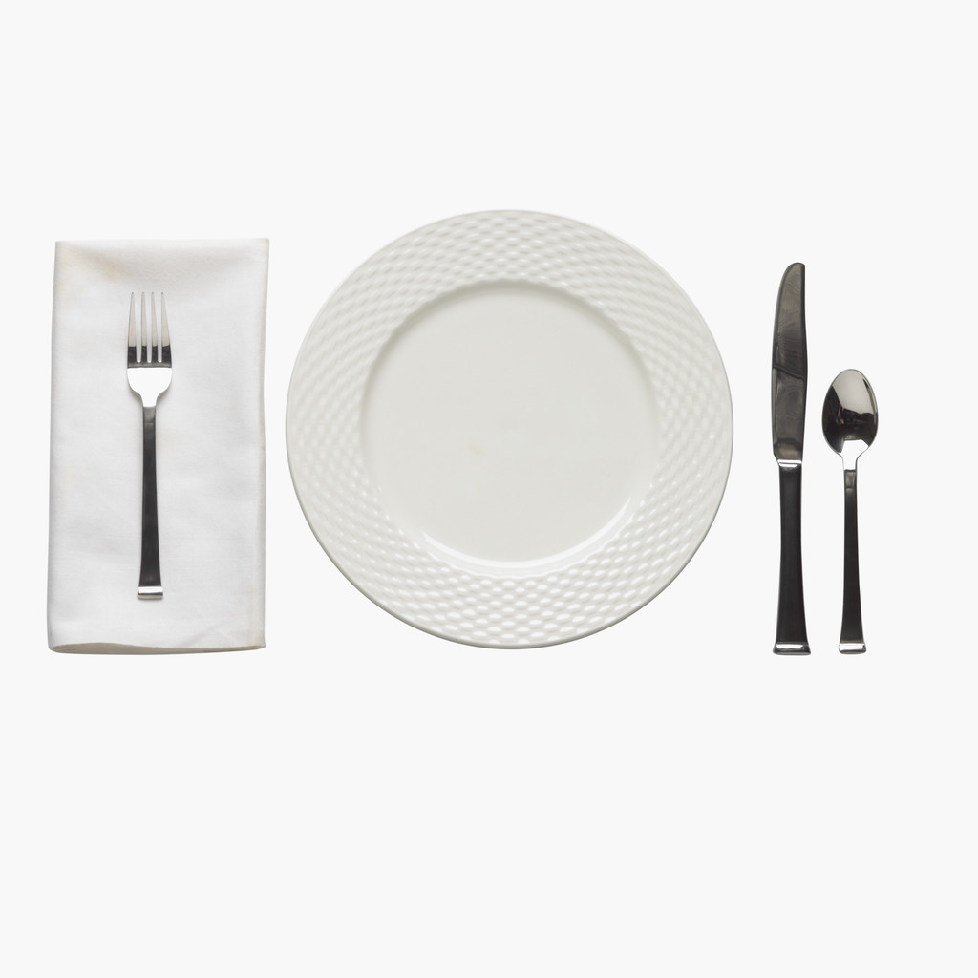
A la carte setting

Slide 2
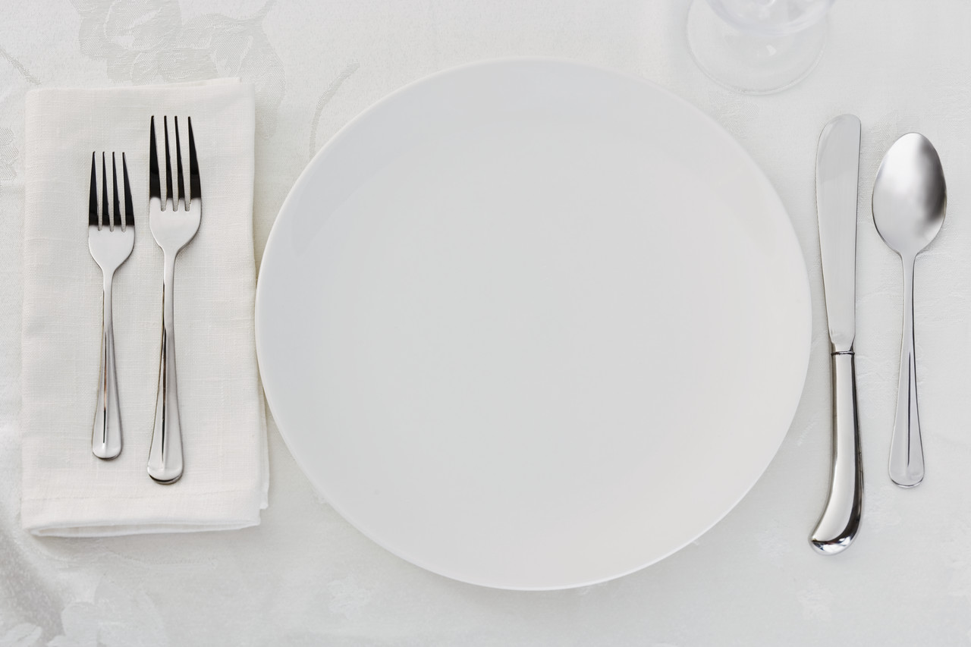
A la carte setting
A basic setting with minimal cutlery

Slide 3
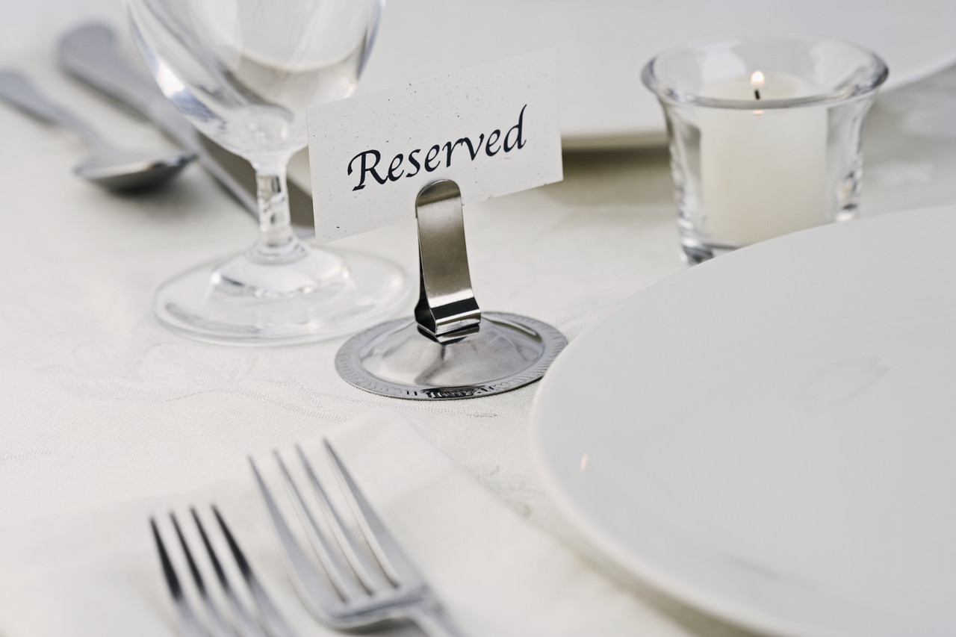
TDH (Table d’ hote) setting
More formal with cutlery for all courses on the menu

Slide 4
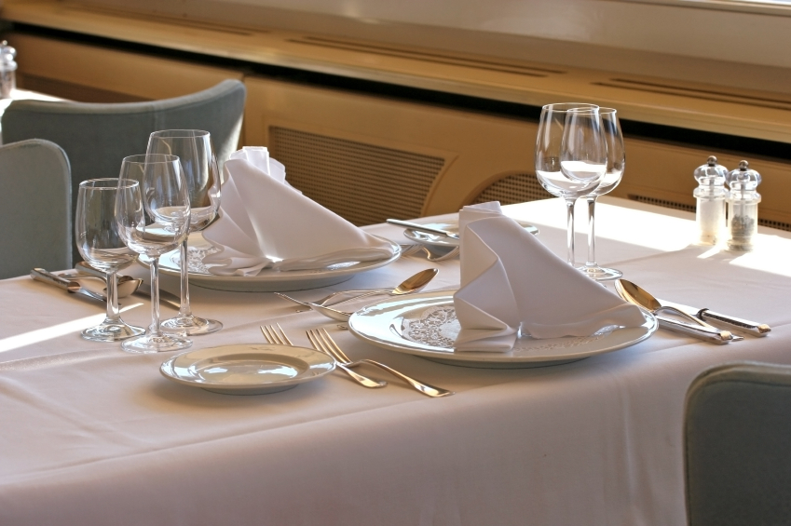
Table d’ hote setting
Usually include red and white wine and water glasses

Slide 5
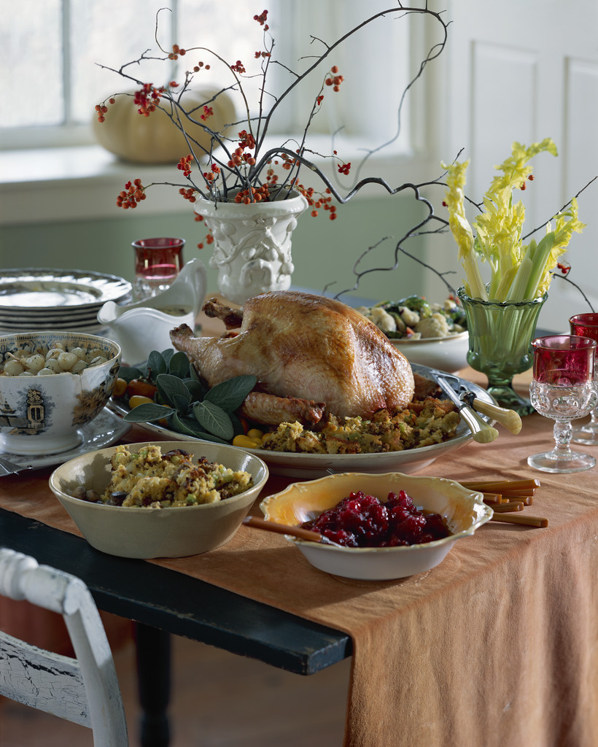
Family service
Usually a table setting where people help themselves to food set down in the middle of the table

Slide 6
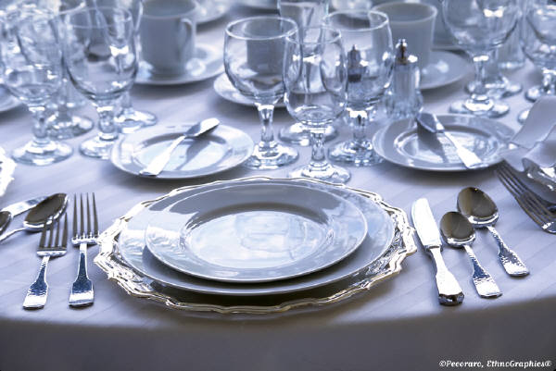
Table d’ hote
A more formal setting for a wedding with underlays at each setting

Slide 7
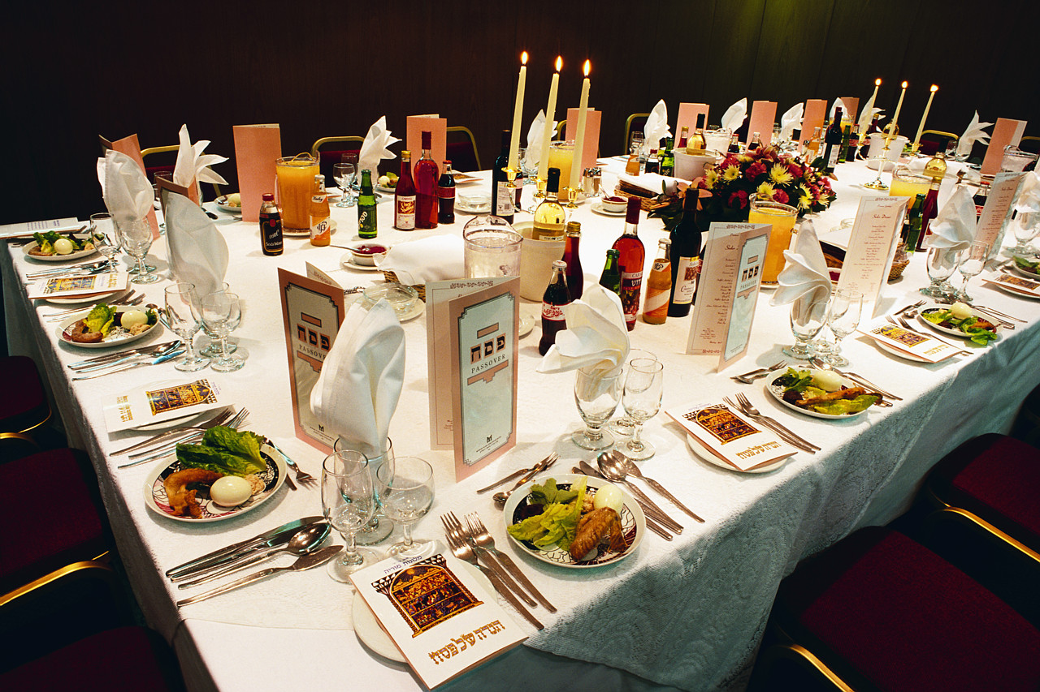
TDH – notice the fork in the middle is higher to add effect

Slide 8
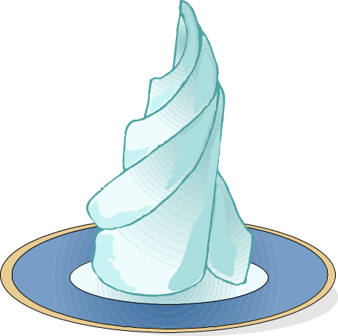
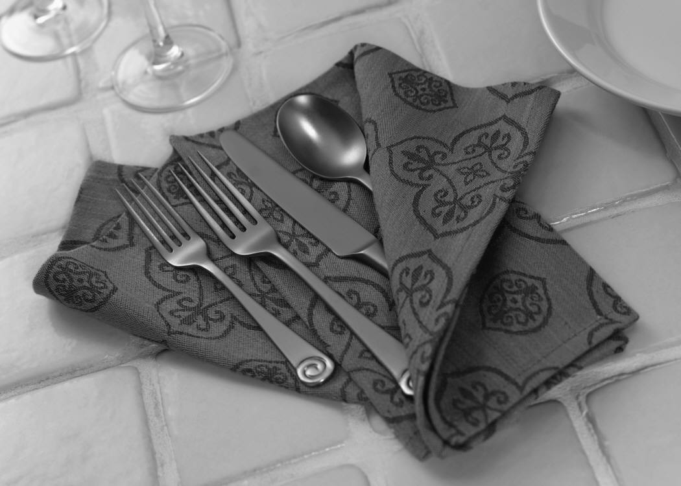
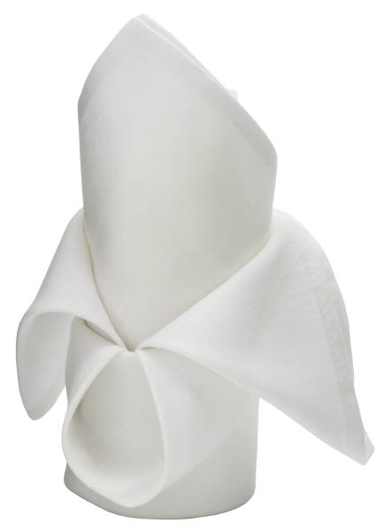
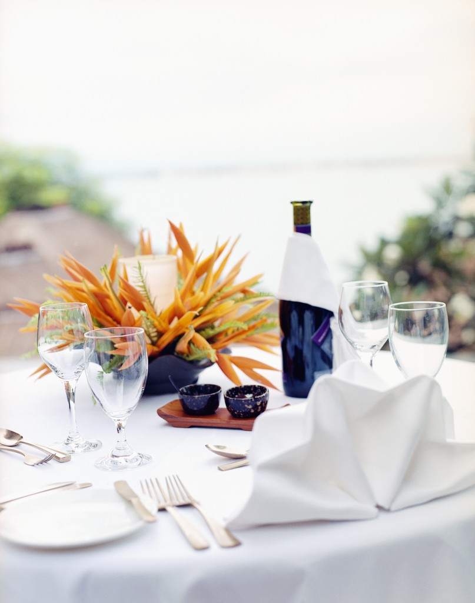
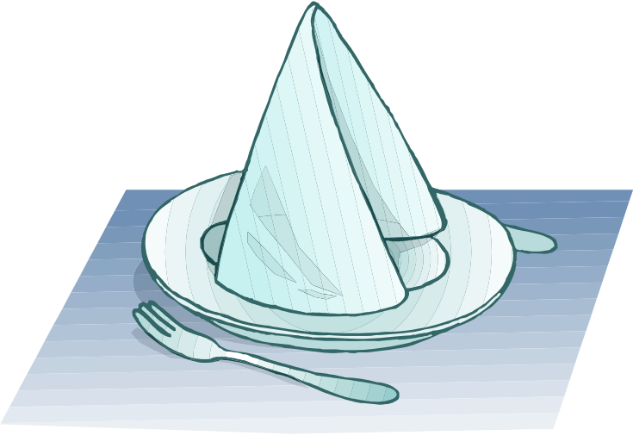
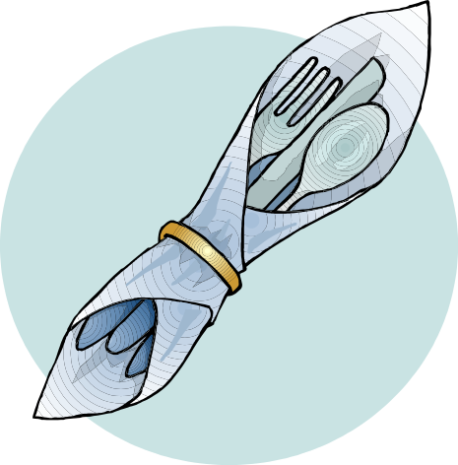
Different napkin styles

Slide 9
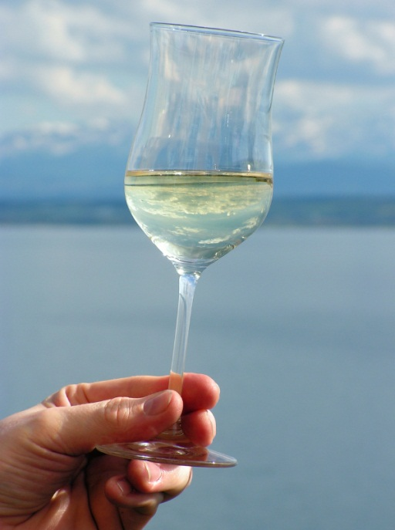
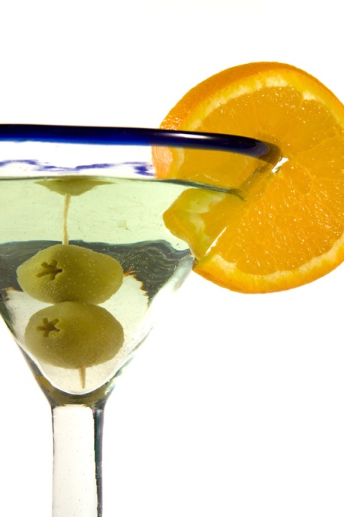
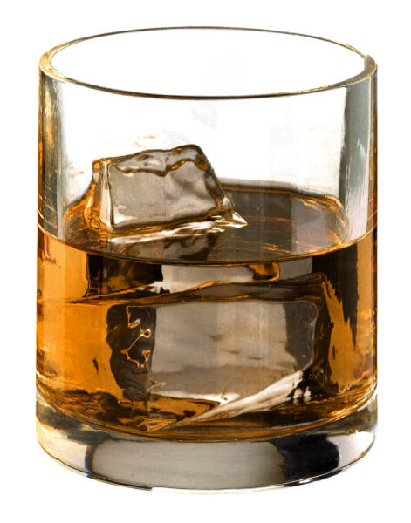
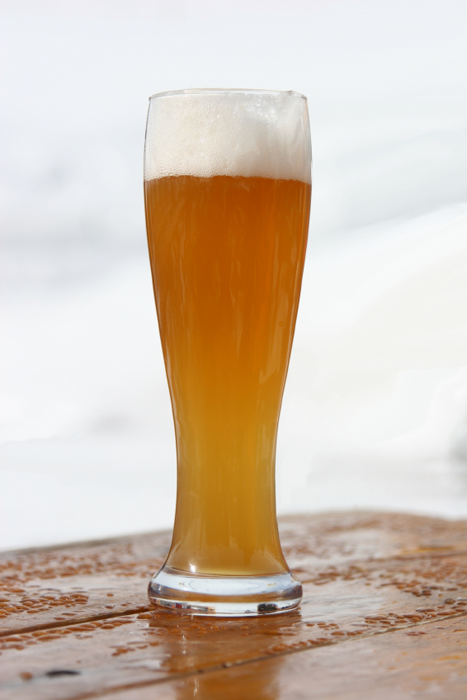
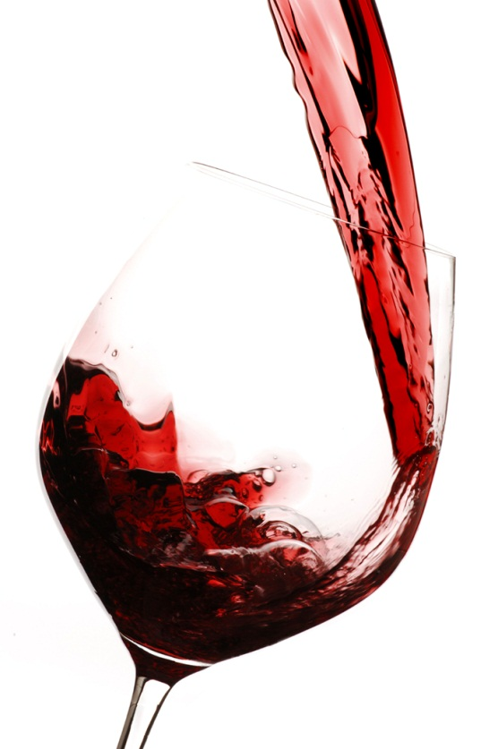

Martini glass
Tumbler
Pint glass
Red wine glass
White wine glass
Champagne glass

Slide 10
The Stillroom
There are certain tasks that must be carried out by each food service team when preparing the stillroom for service:
Check that salt and pepper cruets are full and clean
Prepare and chill the butter
Prepare milk jugs, sugar bowls and trays
Prepare coffee machine for service
Prepare teapots and coffee pots
Prepare tea cups and coffee cups
Prepare the dishwasher
Prepare restaurant crockery and cutlery
Prepare waste bin
Prepare basin for soaking cutlery
Prepare trolley for stacking clean items

Slide 11
Basic sequence of service
Greet guests
Seat guests – ladies first
Present menu to guests – ladies first
Pour water – from customer right, alternatively offer drinks from the bar
Take guests’ food order and pass to kitchen
Adjust cutlery as per guest order
Place bread/rolls on table or serve
Serve food from left
Serve any accompaniments
Once all guests have finished, clear from the right, clear side plates with main course, clear bread basket, butter dish and cruets
Crumb down after each course as required
Present menu for desserts/coffee
Serve dessert course from left
Clear dessert course from right
Put sugar and milk on table
Serve hot beverages from right

Slide 12
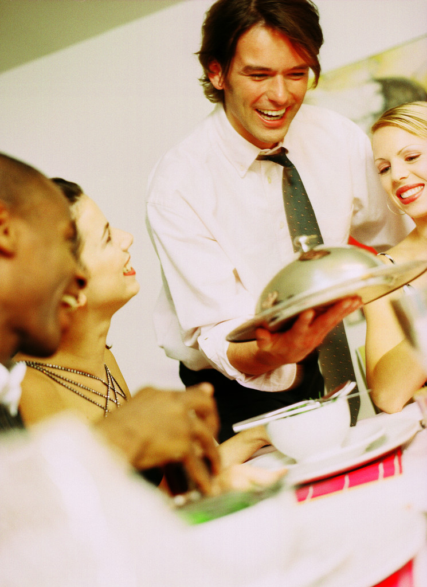
Am I ready?
Am I dressed correctly?
Am I hygienically clean?
Have I followed the checklist?
Is the restaurant ready for customers?
Is the kitchen ready to serve food?
How do I feel?

