Slide 1

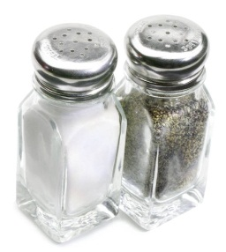


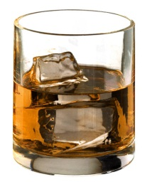

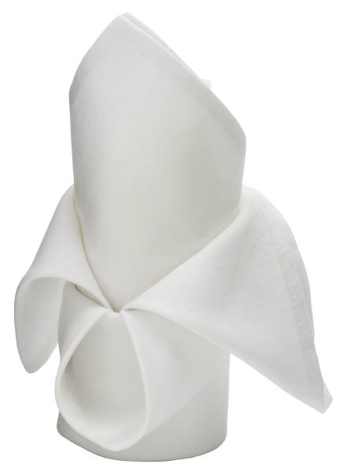

Where does everything go? The only item that is in its correct place is the main plate & side plate, drag the other items into their correct place setting

